Slide 1
Nick’ Guide to Good Database Design

Slide 2
Great Tips for Great Database Design
Solid dimensions are happy dimensions
Every dimension tab should have a primary key that is unique integers.
Every dimension having a foreign key should alway have constraint check to the primary key that it references.
Keep naming conventions consistent across all dimension tables.
Get your facts straight
Always create a denormalized view of every fact table.
Chronically QA your denormalized views against their associated fact tables.
Keep denormalized column headers consistent across all denormalized views.
Don’t slow your roll
When you roll-up a denomalized view, chronically QA the roll-up against its associated denormalized view.

Slide 3
Fact Table | Denormalized View (DV) | DV – QA | Roll-up (RU) | RU – QA
commission_allocations | YES
commission_votes | YES
equity_adjustments
holdings | YES
transactions | YES

Slide 4
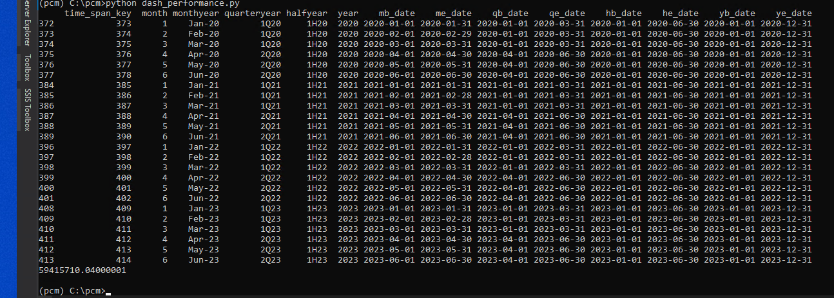
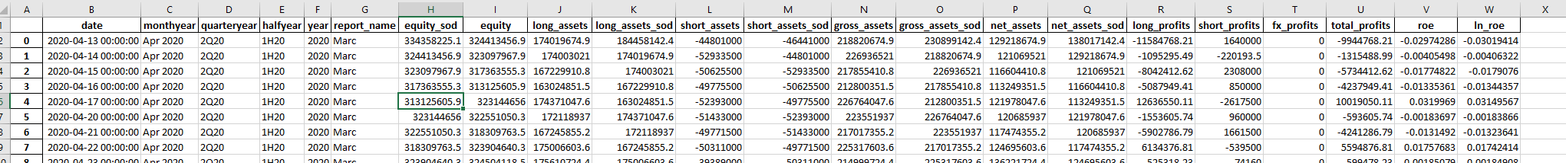
I'm looking to migrate our Shiny dashboard - written in R - to a pure Python -based solution with Dash as the dashboarding platform. Additionally, SQL Server will remain as the back-end data source with light-weight queries performing basic server-side business logic. I'm also wanting to deploy the dashboard for scalable company-wide use. We currently have about 10 users so Shiny solution, from a price-point perspective, suits our needs. However, my goal is to reduce and consolidate the technology footprint that currently drives reporting and data analytics at the fund.

Slide 5
